Slide 1
Machine Failure Prediction
By Kaustubha Ram P

Slide 2
Given Data
The dataset contains sensor data collected from various machines, with the aim of predicting machine failures in advance. It includes a variety of sensor readings as well as the recorded machine failures.
footfall: The number of people or objects passing by the machine.
temp Mode: The temperature mode or setting of the machine.
AQ: Air quality index near the machine.
USS: Ultrasonic sensor data, indicating proximity measurements.
CS: Current sensor readings, indicating the electrical current usage of the machine.
VOC: Volatile organic compounds level detected near the machine.
RP: Rotational position or RPM (revolutions per minute) of the machine parts.
IP: Input pressure to the machine.
Temperature: The operating temperature of the machine.
fail: Binary indicator of machine failure (1 for failure, 0 for no failure).

Slide 3
Objectives:
Exploratory Data Analysis
Compare various models to find the one with highest accuracy
Predict random user input

Slide 4
Requirements:
Python v3.10+
Sklearn
Catboost
Numpy
Pandas
Matplotlib
Seaborn

Slide 5
Steps taken
Check data for outliers and null values and handle them
Perform Exploratory data analysis
Select necessary features
Train different models and the models
Find the model with highest accuracy
Predict custom user input

Slide 6
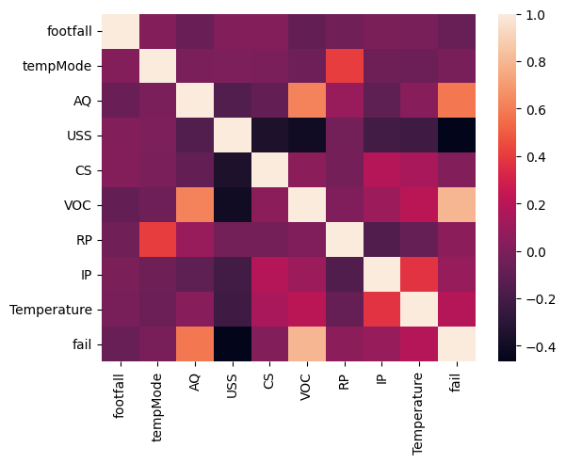
Correlation observed:

Slide 7
Features Selected:
AQ
USS
VOC
Temperature

Slide 8
Results:
Model | Train data accuracy | Test data accuracy
Logistic Regression | 0.9125827814569536 | 0.9206349206349206
Decision Tree Classifier | 0.9880794701986755 | 0.8994708994708994
Random Forest Classifier | 0.9880794701986755 | 0.8994708994708994
KNeighbours Classifier | 0.919205298013245 | 0.91005291005291
Cat Boost Classifier | 0.9549668874172186 | 0.8994708994708994
Gaussian Naive Bayes | 0.9125827814569536 | 0.9153439153439153
Support Vector Classifier | 0.9125827814569536 | 0.9259259259259259
Model Selected: Support Vector Classifier

Slide 9
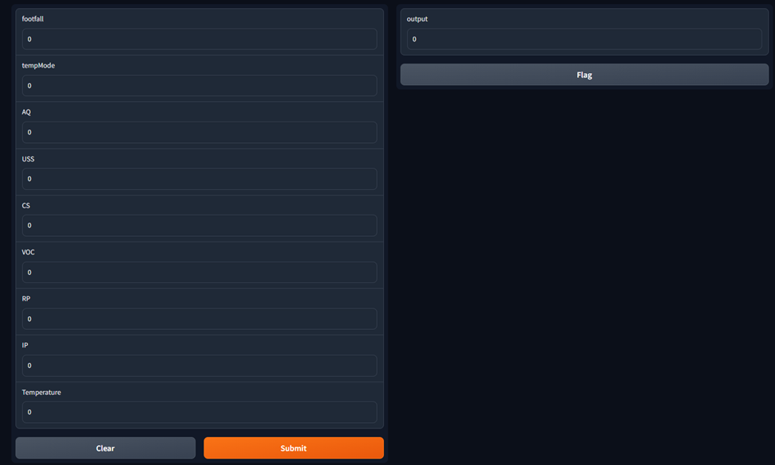
Input Interface:

Slide 10
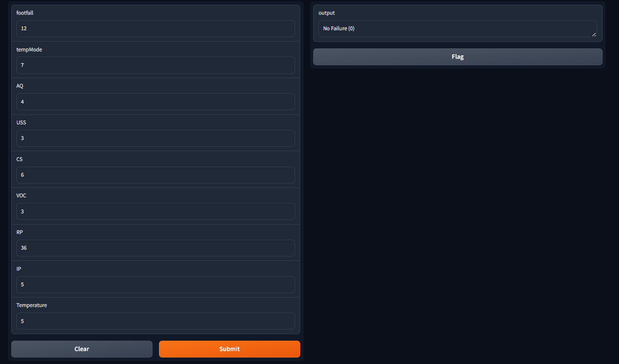
Output:

Slide 11

Output:

Slide 12
Result:
Exploratory data analysis was performed
Models were trained, tested and compared
Support vector classifier was used to predict the user input data since it gave the highest accuracy.
User input was predicted

Slide 13
GitHub Link:
https://github.com/KaustubhaRam/machine_failure_prediction.git

Slide 14
Thank You

